Slide 1
Packaging Made Faster
MSBA 310 Project
Emily El Hajj
Karen Bassil
Kenny Barza
Jason Eid

Slide 2
Introduction
Products
Load Units
Products per packaging
Packaging load capacity
Weight
is special
X-dimension Y-dimension Z-dimension
Quality index
is esp
is one way
X-dimension Y-dimension Z-dimension
Weight
Packaging per load unit
Packages
Weight
is dangerous good
X-dimension Y-dimension Z-dimension
Is special
is one way
What parts to fit in which package?
What packages to fit in which load unit?

Slide 3
Packaging X-Dimension
> mean(packaging_x_dimension)
826.617
 | Linear Regression |  |  | Decision Tree |  | Random Forest
Model | 1 | 2 | 3 | 4 | 5 | 6
RMSE | 423.358 | 424.1813 | 361.616 | 226.837 | 267.289 | 177.514
Predictor/ Splits | 7 predictors | 5 predictors | 5 predictors | 304 splits | 25 splits | 150 trees
Linear Regression Models
CART
Decision Trees

Slide 4
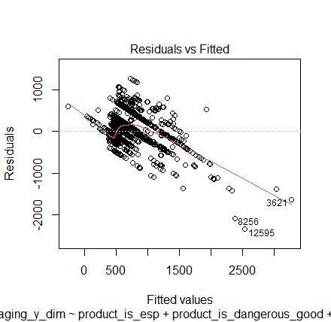
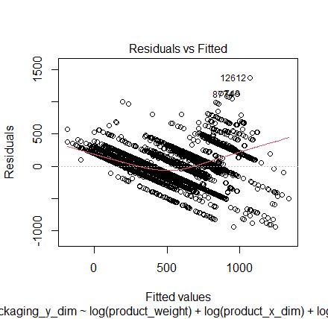
Packaging Y-Dimension
Before
> mean(packaging_y_dimension)
548.4564
 | Linear Regression |  |  |  | Decision Tree
Model | 1 | 2 | 3 | 4 | 5 | 6
RMSE | 268.220 | 268.282 | 268.487 | 207.815 | 154.329 | 154.346
Predictor/ Splits | 7 predictors | 6 predictors | 5 predictors | 7 predictors | 321 splits | 22 splits
After

Slide 5
Packaging Z-Dimension
> mean(packaging_z_dimension)
393.8238
 | Linear Regression |  |  | Decision Tree |  | Random Forest
Model | 1 | 2 | 3 | 4 | 5 | 6
RMSE | 361.319 | 312.961 | 330.147 | 259.230 | 258.531 | 206.482
Predictor/ Splits | 7 predictors | 5 predictors | 5 predictors | 304 splits | 25 splits | 150 trees
Linear Regression Models
CART
Decision Trees

Slide 6
Packaging Load Capacity
> mean(packaging_load_capacity)
356.661
 | Linear Regression |  |  |  | Decision Tree |  | Random Forest
Model | 1 | 2 | 3 | 4 | 5 | 6 | 7
RMSE | 556.630 | 556.579 | 567.0656 | 498.887 | 394.711 | 420.749 | 102.932
Predictor/ Splits | 7 predictors | 6 predictors | 5 predictors | 5 predictors | 291 splits | 36 splits | 150 trees

Slide 7
Packaging is One Way
Sampling Approach
Oversampling
Undersampling
Both
Model Method | Logistic Regression | Decision Tree
Overall Accuracy | 0.967 | 0.974
Sensitivity | 0 | 0.312
Specificity | 1 | 0.996
AUC | 0.635 | 0.731
Predictors/Splits | 7 predictors | 22 splits
20
5
20
5
20
5
20
20
5
5
10
10
> table(data$packaging_is_oneway)
0 1
12670 389

Slide 8
Packaging is One Way
Logistic Regression
Decision tree
Sampling | Oversampling | Undersampling | Both
Overall Accuracy | 0.891751 | 0.88301 | 0.880301
Sensitivity | 0.336 | 0.344 | 0.36
Specificity | 0.910436 | 0.898332 | 0.899946
AUC | 0.648762 | 0.660473 | 0.651974
Predictor | 7 | 7 | 7
Sampling | Oversampling | Undersampling | Both
Overall Accuracy | 0.822566 | 0.886027 | 0.826698
Sensitivity | 0.664 | 0.632 | 0.752
Specificity | 0.831092 | 0.89457 | 0.829209
AUC | 0.847082 | 0.751287 | 0.8347574
Splits | 29 | 21 | 29

Slide 9
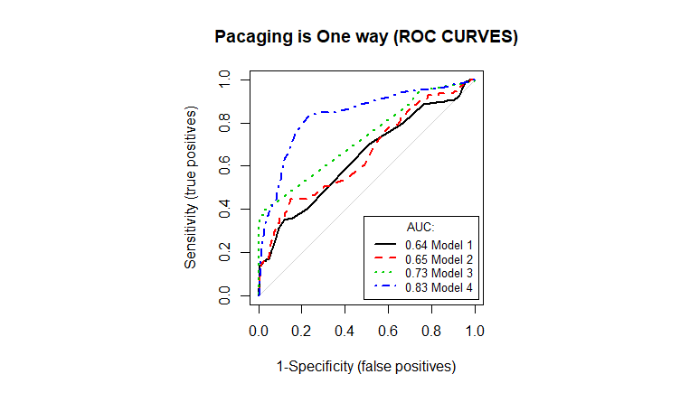
Packaging is One Way
ROC Curves
 | Logistic Regression |  | Decision Tree
Model | 1 | 2 | 3 | 4
Sampling |  | Both |  | Both
Overall Accuracy | 0.967 | 0.882 | 0.974 | 0.827
Sensitivity | 0.000 | 0.360 | 0.312 | 0.752
Specificity | 1.000 | 0.899 | 0.997 | 0.829
AUC | 0.635 | 0.652 | 0.731 | 0.834
Predictor/ Splits | 7 predictors | 7 predictors | 22 splits | 29 splits

Slide 10
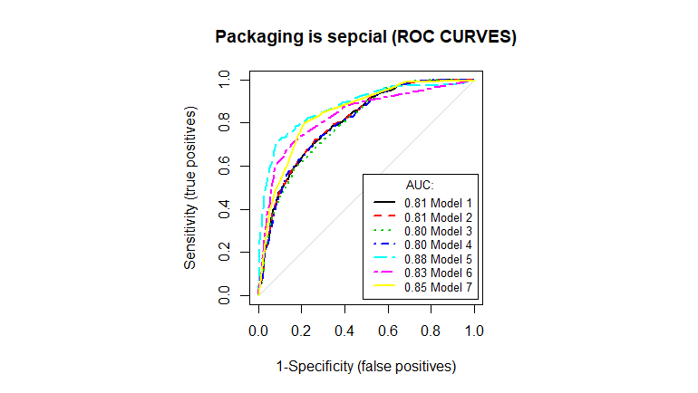
Packaging is Special
 | Logistic Regression |  |  |  | Decision Tree
Model | 1 | 2 | 3 | 4 | 5 | 6 | 7
Sampling |  |  | Under | Both |  |  | Over
Overall Accuracy | 0.725 | 0.697 | 0.767 | 0.776 | 0.854 | 0.825 | 0.789
Sensitivity | 0.129 | 0.05 | 0.464 | 0.456 | 0.703 | 0.619 | 0.801
Specificity | 0.975 | 0.983 | 0.894 | 0.799 | 0.917 | 0.911 | 0.783
AUC | 0.806 | 0.697 | 0.798 | 0.809 | 0.876 | 0.833 | 0.847
Predictor/ Splits | 7 predictors | 4 predictors | 7 predictors | 4 predictors | 149 splits | 27 splits | 28 splits
Linear Regression Models
CART
Decision Trees

Slide 11
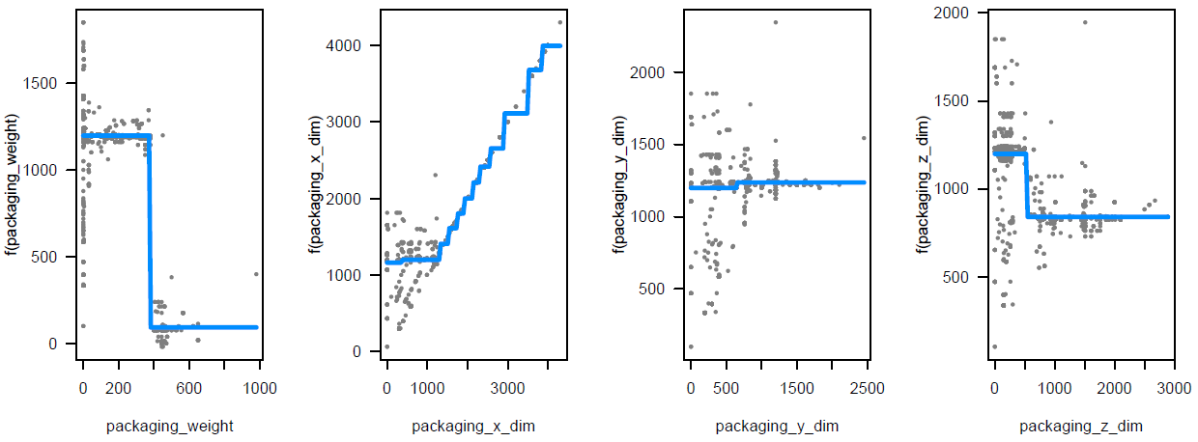
Load Unit X-Dimension
> mean(load_unit_x_dimension)
1260.6
Linear Regression Models
 | Linear Regression |  |  |  | Decision Tree
Model | 1 | 2 | 3 | 4 | 5 | 6
RMSE | 133.7996 | 140.1001 | 139.4196 | 141.0983 | 101.2579 | 104.6099
Predictor/ Splits | 26 predictors | 7 predictors | 8 predictors | 6 predictors | 32 splits | 20 splits
CART
Decision Trees

Slide 12
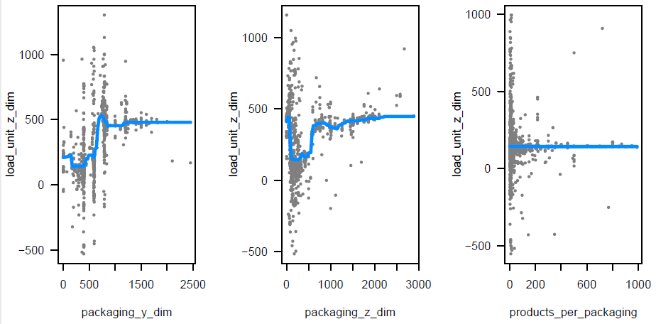
Load Unit Z-Dimension
> mean(load_unit_z_dimension)
420.8882
 | Linear Regression |  |  |  | Decision Tree |  | Random Forest
Model | 1 | 2 | 3 | 4 | 5 | 6 | 7
RMSE | 197.301 | 222.189 | 218.669 | 218.632 | 89.459 | 92.921 | 55.635
Predictor/ Splits | 26 predictors | 7 predictors | 8 predictors | 6 predictors | 67 splits | 42 splits | 150 trees
Linear Regression Models
CART
Decision Trees

Slide 13
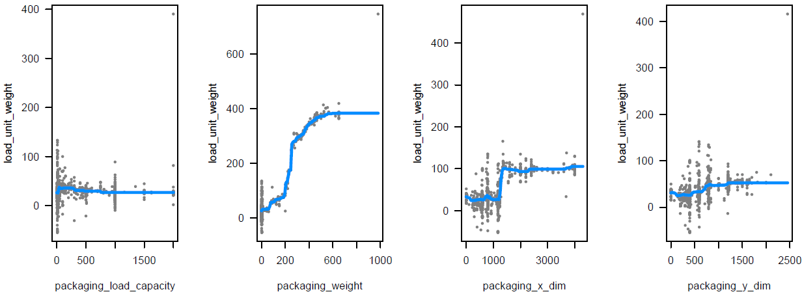
Load Unit Weight
> mean(load_unit_weight)
61.62669
 | Linear Regression |  |  |  | Decision Tree |  | Random Forest
Model | 1 | 2 | 3 | 4 | 5 | 6 | 7
RMSE | 16.292 | 17.022 | 16.942 | 18.011 | 13.189 | 14.558 | 8.381
Predictor/ Splits | 26 predictors | 7 predictors | 8 predictors | 6 predictors | 60 splits | 38 splits | 155 trees

Slide 14
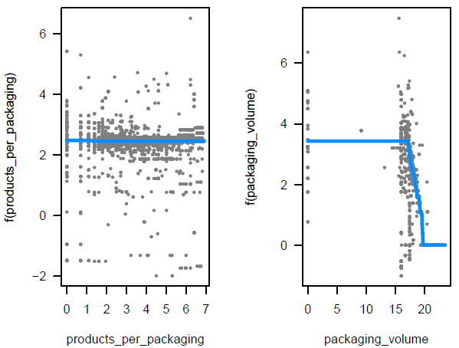
Packaging Per Load Unit
> mean(packaging_per_load_unit)
2.147614
 | Linear Regression |  |  | Decision Tree | Decision Tree
Model | 1 | 2 | 3 | 4 | 5
RMSE | 0.633 | 0.662 | 0.746 | 0.456 | 0.459
Predictor/ Splits | 26 predictors | 8 predictors | 6 predictors | 52 splits | 40 splits
Linear Regression Models
CART
Decision Trees

Slide 15
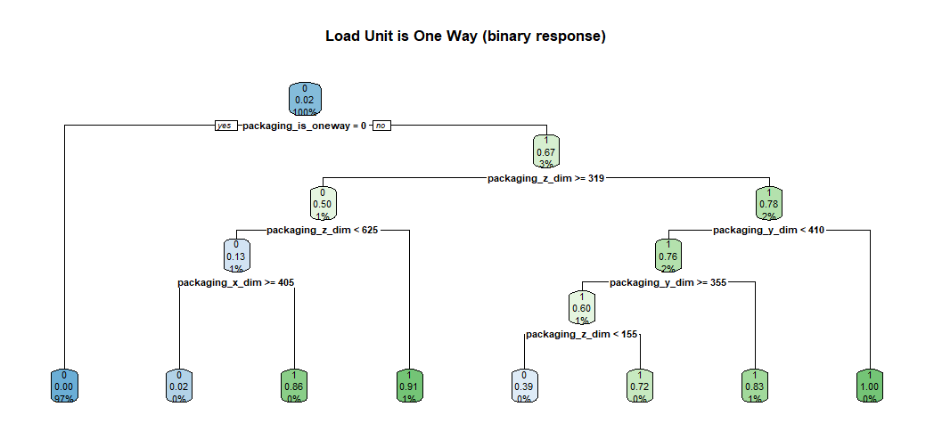
Load Unit is One Way
Decision tree
 | Logistic Regression |  |  | Decision Tree
Model | 1 | 2 | 3 | 4
Overall Accuracy | 0.979 | 0.983 | 0.982 | 0.991
Sensitivity | 0.047 | 0.623 | 0.341 | 0.941
Specificity | 0.999 | 0.992 | 0.996 | 0.993
AUC | 0.523 | 0.916 | 0.776 | 0.991
Predictor/ Splits | 7 predictors | 5 predictors | 4 predictors | 7 splits

Slide 16
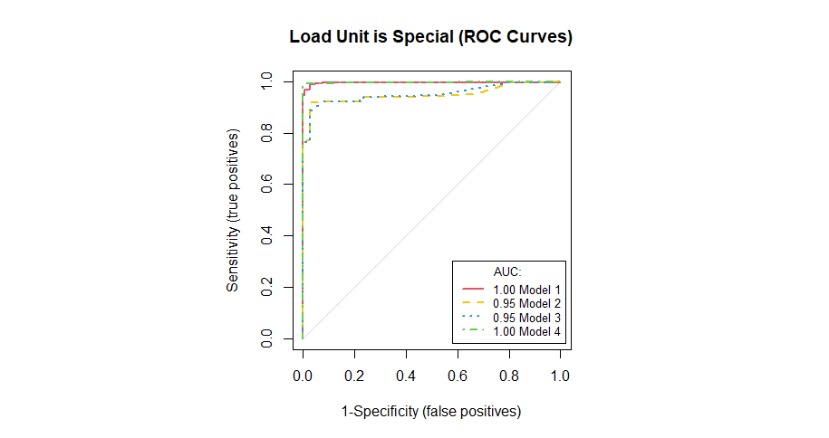
Load Unit is Special
ROC Curves
 | Logistic Regression |  |  | Decision Tree
Model | 1 | 2 | 3 | 4
Overall Accuracy | 0.994 | 0.979 | 0.979 | 0.996
Sensitivity | 0.938 | 0.749 | 0.743 | 0.987
Specificity | 0.999 | 1.000 | 1.000 | 0.997
AUC | 0.998 | 0.946 | 0.949 | 0.997
Predictor/ Splits | 7 predictors | 4 predictors | 2 predictors | 13 splits
Linear Regression Models
CART
Decision Trees

Slide 17
THANK YOU
Do you have any question?
Packaging Made Faster
Emily El Hajj
Karen Bassil
Kenny Barza
Jason Eid

